Slide 1
Diversity and Multiculturalism
Amanda C. Carroll

Slide 2
Who am I?
  Elementary school teacher in favor of promoting and teaching diversity and multiculturalism in the classroom.
Who are you?
  My colleagues (also teachers in an elementary school)
What do I want to improve?
  Controlling my nerves and eye contact.

Slide 3
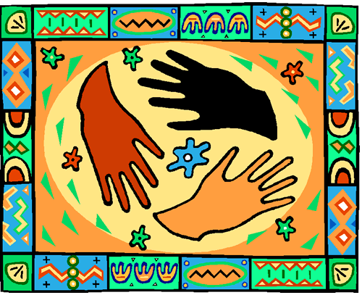
WE ARE ALL DIFFERENT!
Look around the room!
How do we choose friends?

Slide 4
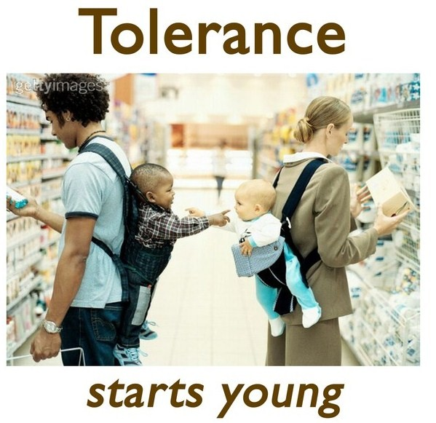
Address problems rather than hide them
Is it too early?
  Starting Small
  Kalisha Carrington, After-school Program Coordinator
Tolerance
Inclusive classrooms
Why teachers are afraid

Slide 5
I am the curriculum!
Makes learning personal
  Kalisha Carrington, After-school Program Coordinator
Students teach students
  Creates healthy classroom environment
  Different learning method
Provides resources
  Little spending!

Slide 6
Tolerance and acceptance
How?
  Eliminates discrimination and exclusion
  Creates open-minded individuals
    People are afraid of what they do not know!
Why?
  Society is changing!
  The workplace

Slide 7
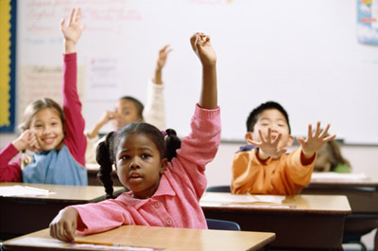
Rural schools vs. Urban schools
Rural
  Homogeneous
    No examples
    No personal connection
    New concept
Urban
  Heterogeneous
    Learning about community
    Interconnectedness
    Can be verified

Slide 8

Suggestions
Cultural trips
Projects and assignments
Discussions
Books
Classroom activities

